Slide 1
CICO Internal Moves Storyboard
1/14/2020

Slide 2
User Actions
Click CICO Internal Moves Button
Access Main View

Slide 3


Data Model
External
Database
Civilian and Military Internal Changes
Contractor internal Changes
(TBD)
SharePoint Lists

Slide 4
Processing Time
Effective Move Date:
Actual Move Date:
Effective Duration(X Days) = Effective Move Date – Today
Actual Duration(X Days) = Actual Move Date - Today
Type of Internal Change:
Projected Return:
Cancel Internal Change?
Personnel Info
Source (Rank):
Name:
Email Address:
Current Location:
Destination:
Losing Org:
Losing Work Section:
Gaining Org:
Gaining Work Section:
Position:
1st Line Supervisor:
Actual Return Date:
Notes:
Bldg:
WIN:
Data Port:
Change Actions
Change Status
AC/S G-1
AC/S G-2
AC/S G-4
AC/S G-6
HCM
OPS
MILITARY
Notes/Comments:
BizApps
Verify SCO/SCA Status:
ITPRAS
Verify ITPRAS Acct:
Cyber Security:
Verify Alt Token:
Verify Admin/Dev Accts:
Mobile Comm/Software
Update Software License Database:
Verify BES Acct:
ITAM
Equipment Setup/On-hand:
Update Database:
Systems Administration
Verify group mailbox ownership:
Verify SIPR Token:
Verify SD/DL Membership:
Administrative
Admin Complete Date:
Admin Comments:

Slide 5
Processing Time
Effective Move Date:
Actual Move Date:
Effective Duration(X Days) = Effective Move Date – Today
Actual Duration(X Days) = Actual Move Date - Today
Type of Internal Change:
Long Term
Projected Return:
Cancel Internal Change?
Personnel Info
Source (Rank):
Name:
Email Address:
Current Location:
Destination:
Losing Org:
Losing Work Section:
Gaining Org:
Gaining Work Section:
Position:
1st Line Supervisor:
Actual Return Date:
Notes:
Bldg:
WIN:
Data Port:
Change Actions
Change Status
AC/S G-1
AC/S G-2
AC/S G-4
AC/S G-6
HCM
OPS
MILITARY
Notes/Comments:
BizApps
Verify SCO/SCA Status:
ITPRAS
Verify ITPRAS Acct:
Cyber Security:
Verify Alt Token:
Verify Admin/Dev Accts:
Mobile Comm/Software
Update Software License Database:
Verify BES Acct:
ITAM
Equipment Setup/On-hand:
Update Database:
Systems Administration
Verify group mailbox ownership:
Verify SIPR Token:
Verify SD/DL Membership:
Administrative
Admin Complete Date:
Admin Comments:

Slide 6
Processing Time
Effective Move Date:
Actual Move Date:
Effective Duration(X Days) = Effective Move Date – Today
Actual Duration(X Days) = Actual Move Date - Today
Type of Internal Change:
Short Term
Projected Return:
Cancel Internal Change?
Personnel Info
Source (Rank):
Name:
Email Address:
Current Location:
Destination:
Losing Org:
Losing Work Section:
Gaining Org:
Gaining Work Section:
Position:
1st Line Supervisor:
Actual Return Date:
Notes:
Bldg:
WIN:
Data Port:
Change Actions
Change Status
AC/S G-1
AC/S G-2
AC/S G-4
AC/S G-6
HCM
OPS
MILITARY
Notes/Comments:
BizApps
Verify SCO/SCA Status:
ITPRAS
Verify ITPRAS Acct:
Cyber Security:
Verify Alt Token:
Verify Admin/Dev Accts:
Mobile Comm/Software
Update Software License Database:
Verify BES Acct:
ITAM
Equipment Setup/On-hand:
Update Database:
Systems Administration
Verify group mailbox ownership:
Verify SIPR Token:
Verify SD/DL Membership:
Administrative
Admin Complete Date:
Admin Comments:

Slide 7
Processing Time
Effective Move Date:
Actual Move Date:
Effective Duration(X Days) = Effective Move Date – Today
Actual Duration(X Days) = Actual Move Date - Today
Type of Internal Change:
Internal
Projected Return:
Cancel Internal Change?
Personnel Info
Source (Rank):
Name:
Email Address:
Current Location:
Destination:
Losing Org:
Losing Work Section:
Gaining Org:
Gaining Work Section:
Position:
1st Line Supervisor:
Actual Return Date:
Notes:
Bldg:
WIN:
Data Port:
Change Actions
Change Status
AC/S G-1
AC/S G-2
AC/S G-4
AC/S G-6
HCM
OPS
MILITARY
Notes/Comments:
BizApps
Verify SCO/SCA Status:
ITPRAS
Verify ITPRAS Acct:
Cyber Security:
Verify Alt Token:
Verify Admin/Dev Accts:
Mobile Comm/Software
Update Software License Database:
Verify BES Acct:
ITAM
Equipment Setup/On-hand:
Update Database:
Systems Administration
Verify group mailbox ownership:
Verify SIPR Token:
Verify SD/DL Membership:
Administrative
Admin Complete Date:
Admin Comments:

Slide 8
Processing Time
Effective Move Date:
Projected Return:
Effective Duration(X Days) = Effective Move Date – Today
Type of Internal Change:
Seat Change
Cancel Internal Change?
Personnel Info
Source (Rank):
Name:
Email Address:
Current Location:
Destination:
Losing Org:
Losing Work Section:
Gaining Org:
Gaining Work Section:
Position:
1st Line Supervisor:
Actual Return Date:
Notes:
Bldg:
WIN:
Data Port:
Change Actions
Change Status
AC/S G-1
AC/S G-2
AC/S G-4
AC/S G-6
HCM
OPS
MILITARY
Notes/Comments:
BizApps
Verify SCO/SCA Status:
ITPRAS
Verify ITPRAS Acct:
Cyber Security:
Verify Alt Token:
Verify Admin/Dev Accts:
Mobile Comm/Software
Update Software License Database:
Verify BES Acct:
ITAM
Equipment Setup/On-hand:
Update Database:
Systems Administration
Verify group mailbox ownership:
Verify SIPR Token:
Verify SD/DL Membership:
Administrative
Admin Complete Date:
Admin Comments:

Slide 9
Form Fields

Slide 10
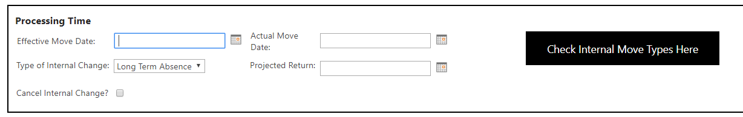
Processing Time
[Projected Return Date] only appears when
Seat Changes and Internal Moves are selected
From [Internal Change]

Slide 11
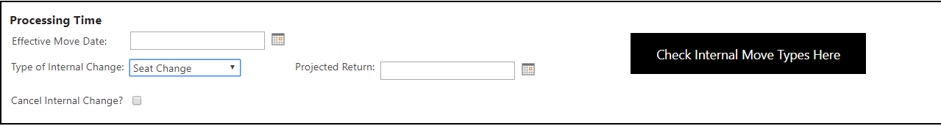
Processing Time
Remove Seat Change option From [Internal Change]

Slide 12
Processing Time
Reuse Cancel Internal Change
Red Button from CICO
Add [Next Review Date] field

Slide 13
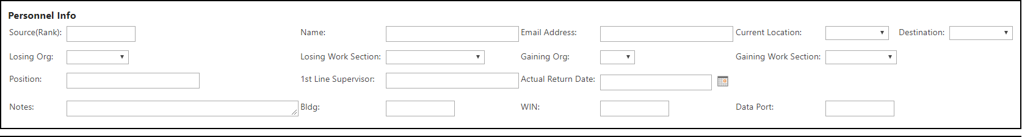
Personnel Info Long/Short Term Changes
Included Fields:
Full Name(first, last, mi)
Movement Type(Long, Short, Internal)
3. Source(Rank)
4. Email
5. Current Location(Move Current Location to Position Row)
6. Position
1st Line Supervisor
Actual Return Date
Projected Return Date(use to be next review date)
10. Notes
11. Building
12. WIN
13. Data Port
These fields will appear when
Long Term and Short Term choices
are selected at Processing Time section

Slide 14
Personnel Info Internal Moves
Included Fields:
Name
Source
Email
Current Location
Destination Location
Losing Organization
Gaining Organization
Losing Work Section
Gaining Work Section
Position
1st Line Supervisor
Building
WIN
Data Port
These fields will appear when
Internal Moves choice
is selected at Processing Time section

Slide 15
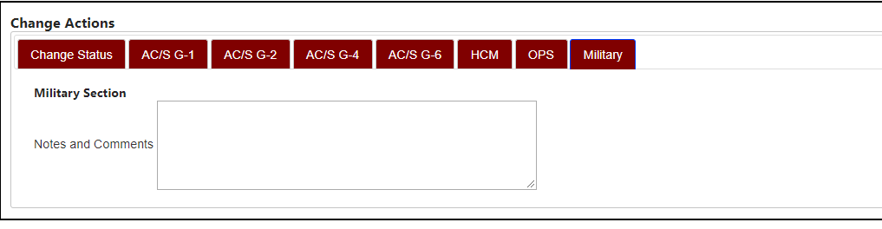
Change Actions
Remove Seat Change option From [Change Status],
[HCM],[OPS] and [Military] tabs

Slide 16
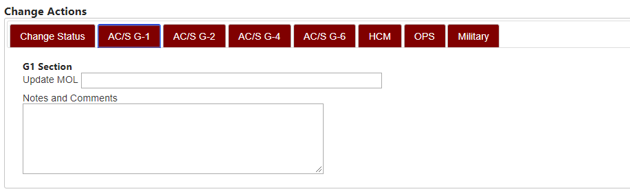
Change Actions
Convert text fields to check boxes.
No changes to [Notes & Comments] field

Slide 17
Change Actions
Add [Modified BY] according sections.
Use Case: If G1 modified

Slide 18
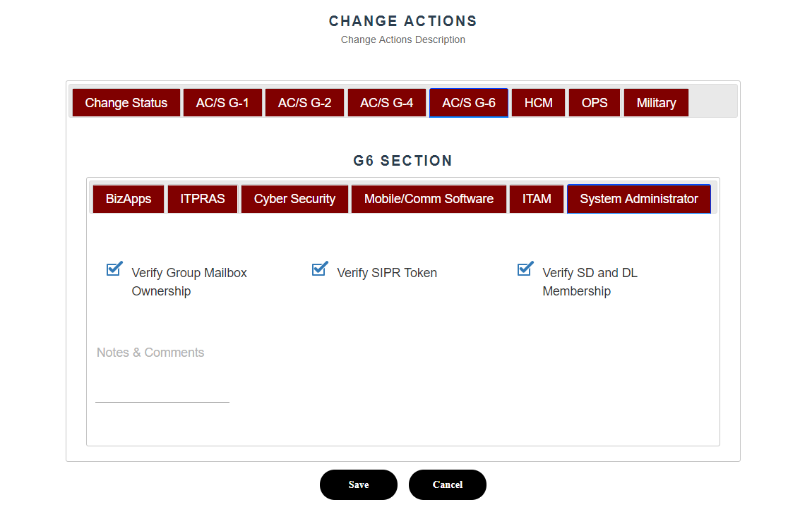
Change Actions
Add [Update GAL] to [System Administrator] tab
Add Quality Control tab or add under System Administrator tab
Add QA check box either under Quality Control or System Administrator tabs
When QA box is checked item is closed and moved off view pages

Slide 19
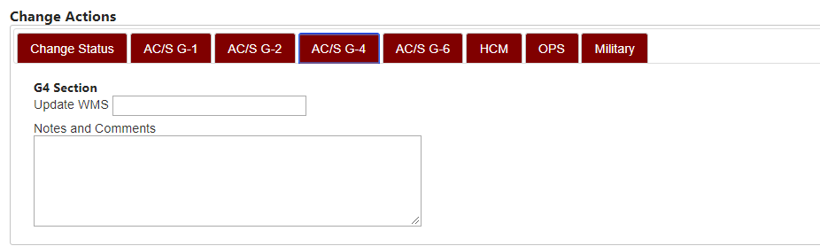
Change Actions
Hide G-4 section
Change to Military to MILManpower.
This tab can be hidden.

Slide 20
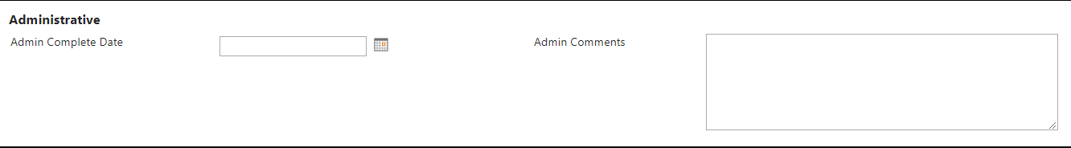
Administrative
Add [DTS] and [GTCC]
fields to administrative section of form
When both [DTS] and [GTCC]
Checkboxes are checked, append
Date to [Admin Completed Date]
field

Slide 21
Workflows
G-6 QC: Email will be forwarded to G-6 QC group
Update GAL: Email will be sent to users to update MilConnect
G-1 Admin: Email will be sent to G-1 if checkbox is changed

Slide 22
Permissions
Refer to CICO Permissions Groups
G-6 QA Group will be new group for G-6 QC workflow

Slide 23
Long/Short Term Views

Slide 24
Internal Views

Slide 25
Actual Return Date Only Views
Actual Return Date Only View Filter:
[Actual Return Date] is not empty

Slide 26
G1 Item Views
Actual Return Date Only View Filter:
[Actual Return Date] is not empty

Slide 27
G2 Item Views
Actual Return Date Only View Filter:
[Actual Return Date] is not empty

Slide 28
Use Cases
Once info pushed by HCM any updates to change module would be done manually.
Long-Term and Short-Term should be the same

